Slide 1
CSE-2204
Computer Architecture and Organization

Slide 2
Lecture – 1, 2

Slide 3
Text Books
Computer Architecture and Organization
Hayes J.P., McGraw-Hill.
Computer organization and design: The hardware/software interface
Patterson D.A., Hennessy J.L., Morgan Kaufmann.

Slide 4
Reference Book
Computer Architecture: A Quantitative Approach
Patterson D.A., Hennessy J.L., Morgan Kaufmann.

Slide 5
Fixed-Point Arithmetic
Addition
Subtraction
Multiplication
Division

Slide 6
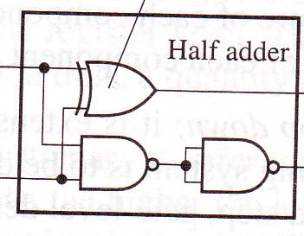
Half Adder
X₀ Y₀ | S₀ C₀
0 0 | 0 0
0 1 | 1 0
1 0 | 1 0
1 1 | 1 1
X₀
S₀
Y₀
C₀
S₀ = X₀ ⊕ Y₀ C₀ = X₀Y₀

Slide 7
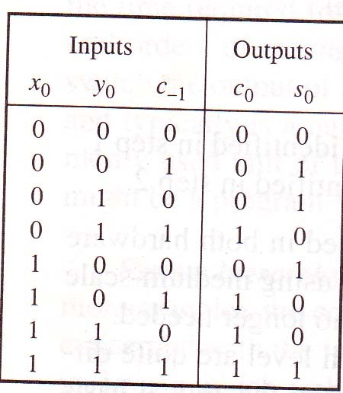
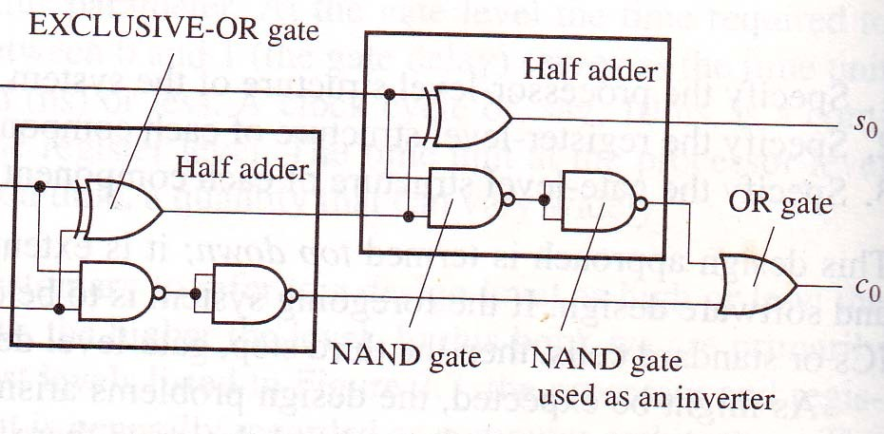
Full Adder
S₀ = X₀ ⊕ Y₀ ⊕ C₋₁
C₀ = X₀Y₀ + X₀C₋₁ + Y₀C₋₁

Slide 8
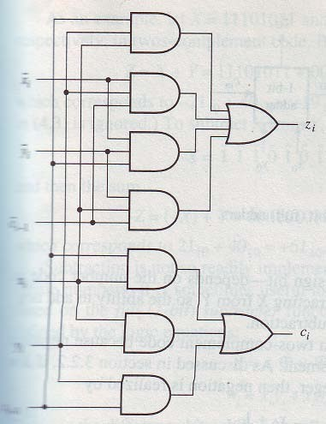
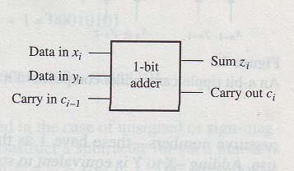
Full Adder

Slide 9
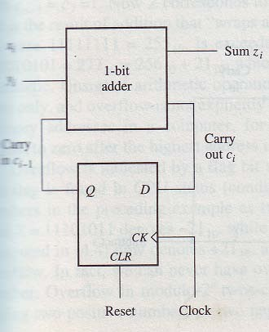
Serial Binary Adder
Least expensive circuit in terms of hardware cost.
It adds the numbers bit by bit and so requires n clock cycle to compute the sum of two n-bit numbers.
Circuit size independent of n.

Slide 10
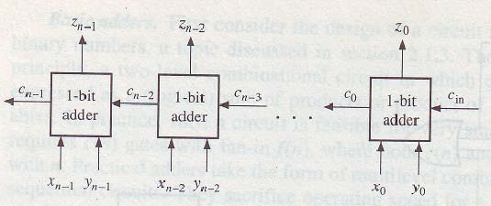
Ripple Carry Adder
A 1 appearing on the carry in line of a 1-bit adder cause it to generate a 1 on its carry out line. So, the carry signal propagate through the adder from right to left.
The maximum signal propagation delay is nd, where d is the delay of a full-adder stage.
The amount of hardware increase linearly with n.

Slide 11
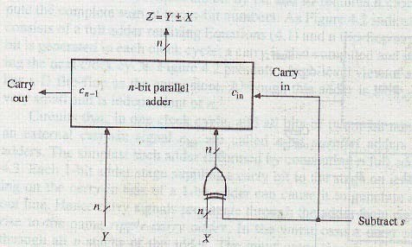
2’s Complement Adder-Subtracter
When s =0, then X ⊕ s = X
When s=1, then X ⊕ s = X

Slide 12
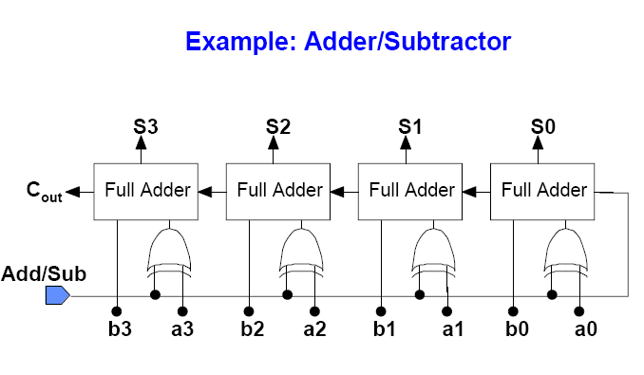
2’s Complement Adder- Subtracter

Slide 13
Overflow
When the result of an arithmetic
operation exceeds the
standard word size n, overflow occurs.
Example: let n=8, X=11101011=235₁₀ and Y=00101010=42₁₀ Z = X+Y = 11101011 + 0101010 = 00010101 = 21₁₀
with C_{n-1} = C₇ = 1.
C₇Z = 100010101 = 277₁₀ = 256₁₀ + 21₁₀
The result of an addition simply wraps around when the largest number 2^{n}-1 is exceeds.
For n, the number range for unsigned number is 0 to 2^{n}-1

Slide 14
Overflow
We can never have overflow on adding a negative and positive number.
Example: let n=8 X=11101011=-21₁₀ and Y=00101010=+42₁₀
Z = X+Y = 00010101 = 21₁₀ and C₇ = 1.
So, C_{n-1} = 1 does not indicate overflow.
Overflow in 2’s complement addition can result from adding
two positive numbers or
two negative numbers.

Slide 15
Overflow
Case 1: Two numbers are positive.
Let n = 4, 7 + 3 = 0111+0011 = 1010 so, c_{n-2} = 1
C_{n-2} =1 indicates that the magnitude of the sum exceeds the n-1 bits allocated to it.
Case 2: Two numbers are negative.
Let n=4, -7 = 1001, -3 = 1101
so, 1001+1101 = 10110 so, c_{n-2} = 0
C_{n-2} =0 indicates the overflow.

Slide 16
Overflow
^{X}n-1 | ^{Y}n-1 | ^{C}n-2 | ^{Z}n-1 | v
0 | 0 | 0 | 0 | 0
0 | 0 | 1 | 0 | 1
0 | 1 | 0 | 1 | 0
0 | 1 | 1 | 0 | 0
1 | 0 | 0 | 1 | 0
1 | 0 | 1 | 0 | 0
1 | 1 | 0 | 1 | 1
1 | 1 | 1 | 1 | 0
Z_{n −1}Z_{n −2}......Z₀ := X_{n −1} X_{n −2}......X₀ + Y_{n −1}Y_{n −2}......Y₀
^{v = X}n −1^{Y}n −1^{C}n −2 ^{+ X}n −1^{Y}n −1^{C}n −2
^{v = C}n −1 ^{⊕ C}n −2

Slide 17
Carry-Lookahead Adder
It reduce the time required to form carry signals.
It computes the input carry needed b y stage I directly from carrylike signals obtained from all the preceding stages i-1, i-2, ….., 0, rather than waiting for normal carries to ripple slowly from stage to stage.
Adders that use this principle are called carry-lookahead adders.

Slide 18
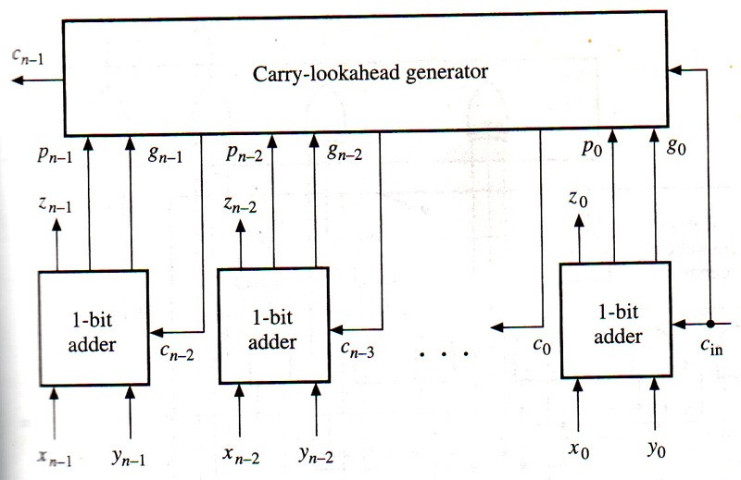
Carry-Lookahead Adder
Two signals:
generate signal, g_{i} = x_{i}y_{i} propagate signal, p_{i} = x_{i} + y_{i}
c_{i} = x_{i}y_{i} + x_{i}c_{i-1} + y_{i}c_{i-1}
c_{i} = g_{i} + p_{i}c_{i-1}
^{c}i-1 ^{= g}i-1 ^{+ p}i-1^{c}i-2
^{c}i ^{= g}i ^{+ p}i^{g}i-1 ^{+ p}i^{p}i-1^{c}i-2

Slide 19
4-bit Carry-Lookahead Adder
▪
^{c}i ^{= g}i ^{+ p}i^{g}i-1 ^{+ p}i^{p}i-1^{c}i-2
c₀ = g₀ + p₀c_{in}
c₁ = g₁ + p₁g₀ + p₁p₀c_{in}
c₂ = g₂ + p₂g₁ + p₂p₁g₀ + p₂p₁p₀c_{in}
c₃ = g₃ + p₃g₂ + p₃p₂g₁ + p₃p₂p₁g₀ + p₃p₂p₁p₀c_{in}
z_{i} = x_{i} ⊕ y_{i} ⊕ c_{i-1} can be written as z_{i} = p_{i} ⊕ g_{i} ⊕ c_{i-1}

Slide 20
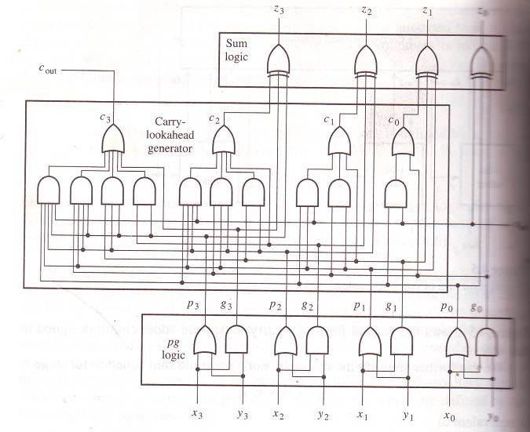
4-bit Carry-Lookahead Adder

Slide 21
4-bit Carry-Lookahead Adder
Maximum delay is 4d, where d is the average gate delay. It is independent of number of input n.
The number of gates grows in proportion to n² as n increases.
The complexity of the carry generation logic in the carry lookahead adder, including its gate count, its maximum fan-in, and its maximum fan-out, increase steadily with n.
It limits n to 4.

Slide 22
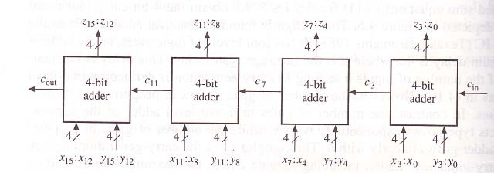
Adder Expansion
If we replace n 1-bit adder stages in the n-bit ripple carry adder with n k-bit adders, we obtain an nk-bit adder.
16-bit adder composed of 4-bit adders linked by ripple-carry propagation

Slide 23
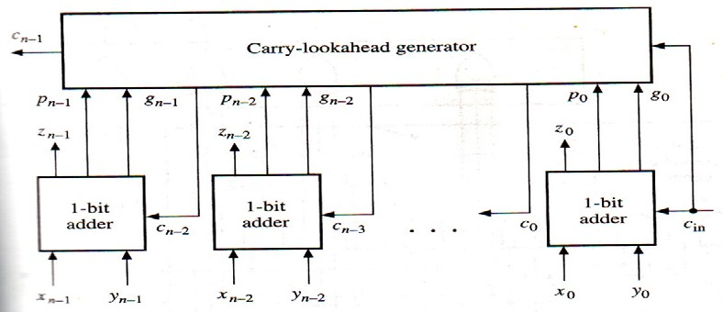
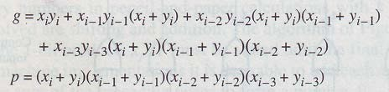
Adder Expansion
If we replace n 1-bit adder stages in the n-bit carry look-ahead adder with n k-bit adders, we obtain an nk-bit adder.
16-bit adder composed of 4-bit adders linked by carry look-ahead

Slide 24
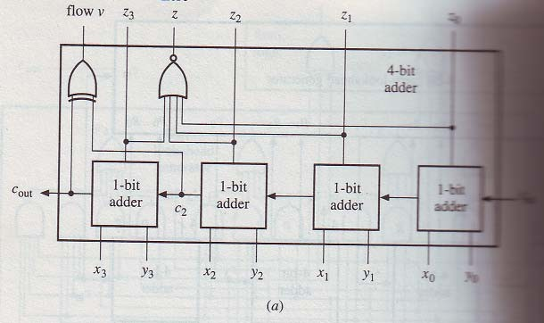
Complete 2’s Complement Adder-Subtracter

Slide 25
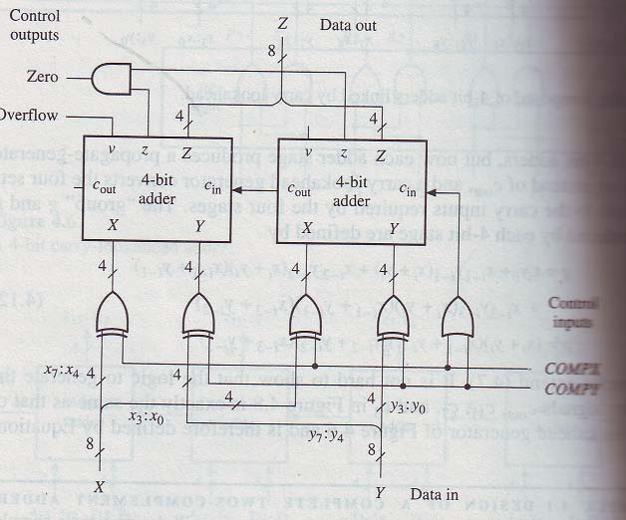
Complete 2’s Complement Adder-Subtracter

Slide 26
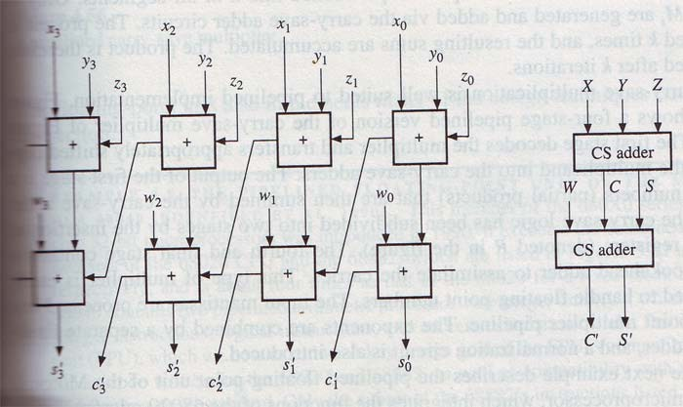
Carry-Save Adder

Slide 27
Carry-Save Adder
One of the major speed enhancement techniques used in modern digital circuits is the ability to add numbers with minimal carry propagation.
The basic idea is that three numbers can be reduced to 2, in a 3:2 compressor, by doing the addition while keeping the carries and the sum separate.
10111001
00101010
00111001
Sum: 10101010
Carry: 00111001
Result: 100011100
The sum and carry can then be recombined in a normal addition to form the correct result.

